Slide 1
Puppet

Slide 2
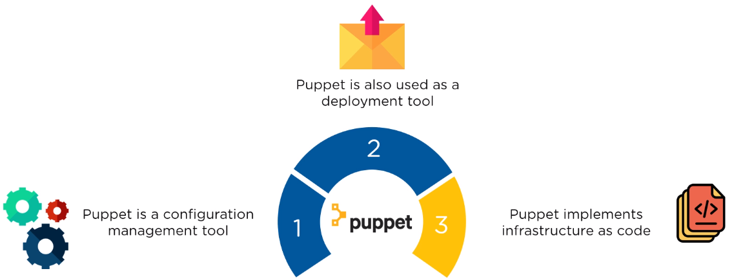
What is Puppet?

Slide 3
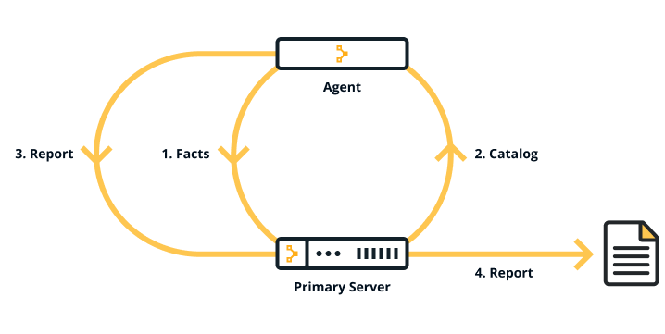
Puppet Architecture

Slide 4
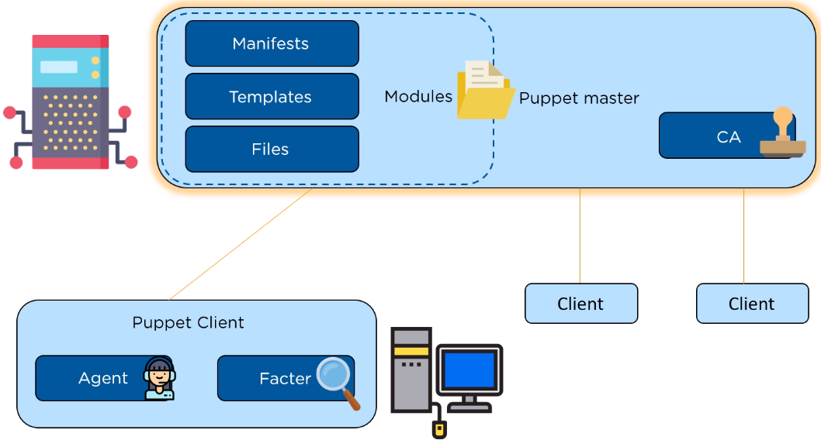
Puppet Architecture

Slide 5
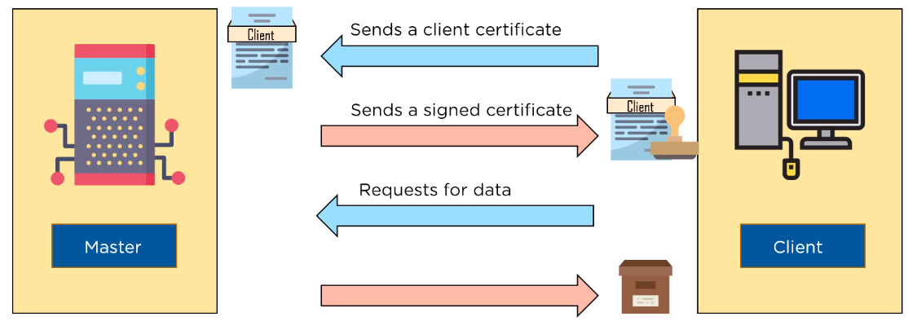
SSL Certification

Slide 6
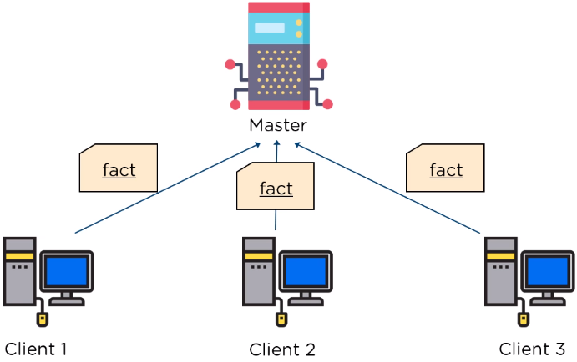
Factor sends state of the client to master

Slide 7
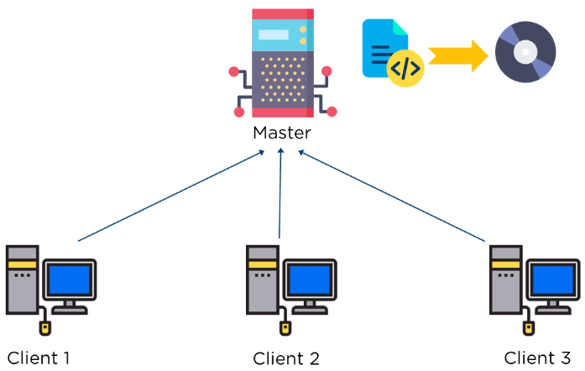

Based on facts master compiles manifests

Slide 8
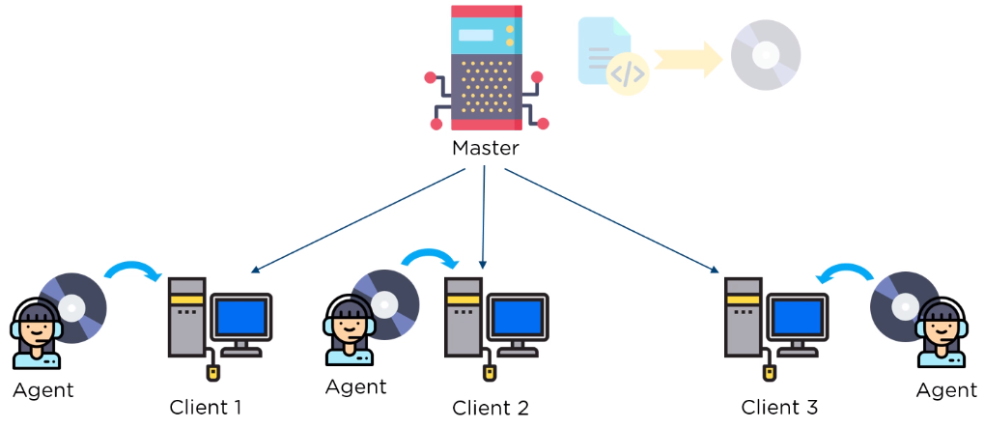
Agent on the client, executes the catalog

Slide 9
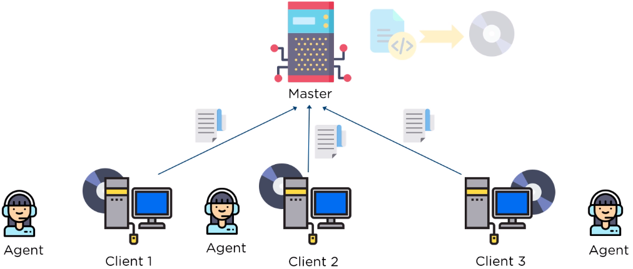
Report is sent back to the master

Slide 10
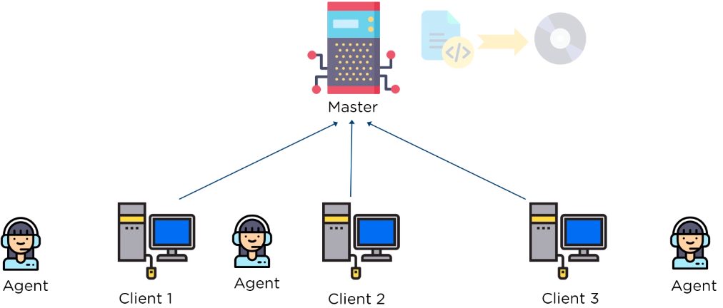

Report is generated and sent every 30 minutes

Slide 11
The components that make up Puppet
Puppet Server and Puppet agent
Configured in an agent-server architecture
Includes a built-in certificate authority for managing certificates
Performs the role of the primary node and also runs an agent to configure itself.
Facter
Gathers facts about an agent node such as its hostname, IP address, and OS
Hiera
Separate data from the code and place it in a centralized location.
PuppetDB
All data generated (for example facts, catalogs, reports) is stored in PuppetDB

Slide 12
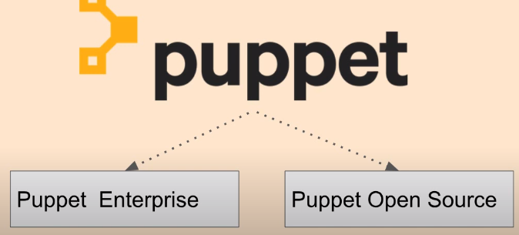

Slide 13
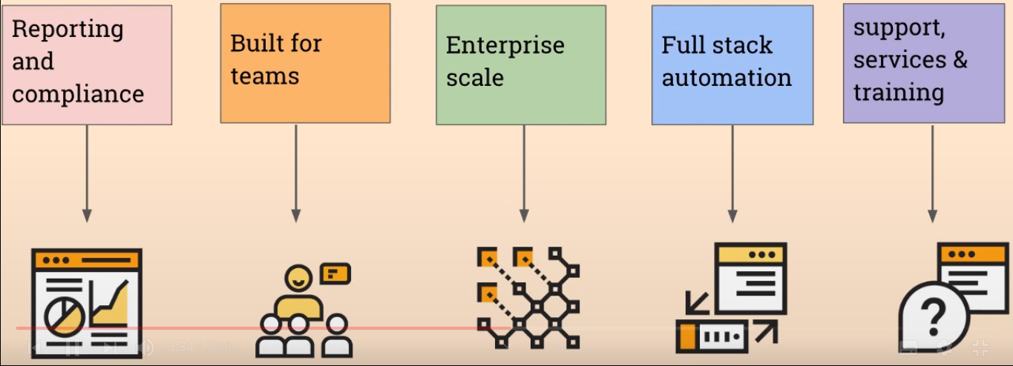
Why Puppet Enterprise

Slide 14
Thanks

